Slide 1
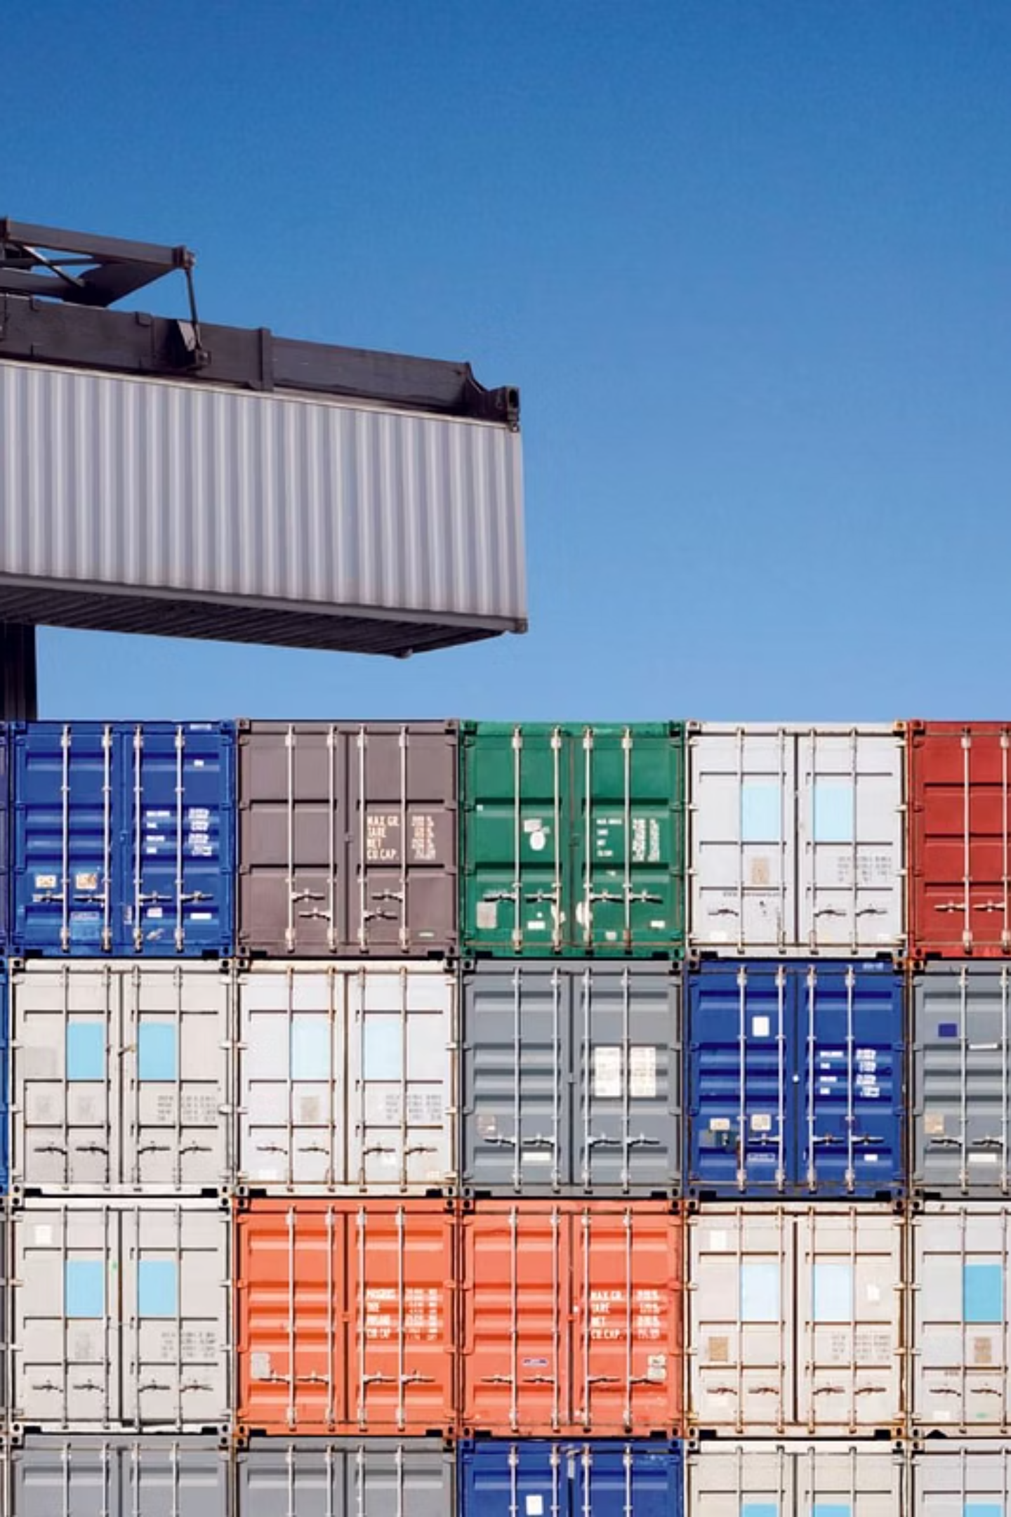
Docker Best Practices: Building Fast, Small, and Secure Images
A comprehensive guide to optimizing your Docker workflow through proven techniques, security scanning, and CI/CD integration.

Slide 2
Agenda
01
02
03
Why Docker Best Practices Matter
Image Optimization Techniques
Security Scanning & Compliance
Methods to reduce size and improve performance
Tools and approaches for vulnerability detection
Understanding the importance of optimization and security
04
05
Demo / Tool Overview
Summary & Q&A
Practical examples of security scanning tools
Key takeaways and discussion

Slide 3
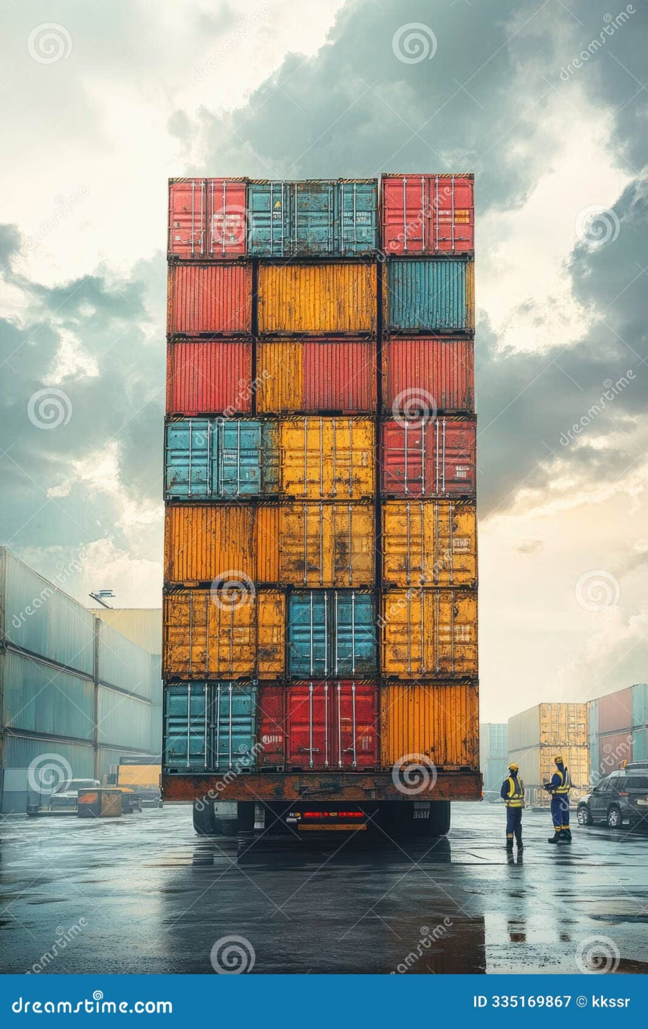
Why Best Practices Matter
Benefits of Containers
Risks When Ignored
Containers provide portability, speed, and consistency across environments
Bloated images → slow CI/CD & high storage cost
Security vulnerabilities in base layers
Hard to maintain & troubleshoot
Goal: Fast, Small, Secure Images ✅

Slide 4
General Best Practices
Use official & minimal base images
Keep Dockerfile clean & simple
Pin versions of dependencies
Specify exact versions of OS packages, tools, and dependencies
Prefer alpine or distroless images to reduce attack surface and size
Maintain readability and simplicity for better maintainability
Apply multi-stage builds
Avoid running as root user
Separate build environment from runtime environment
Reduce security risks by using non-privileged users

Slide 5
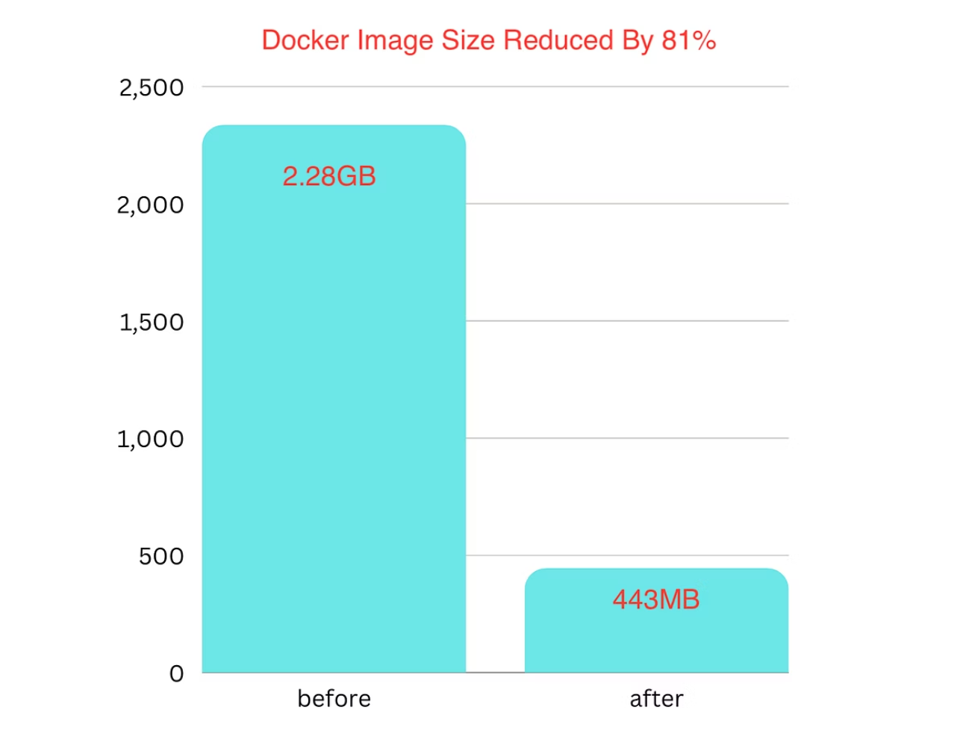
Image Optimization Techniques
Use multi-stage builds to reduce final size
Combine commands with && to minimize layers
Use .dockerignore to exclude unnecessary files
Clean up (apt-get clean, remove cache/temp files)
Prefer static binaries where possible
RUN apt-get update && apt-get install -y curl \&& rm -rf /var/lib/apt/lists/*
Optimized images lead to faster deployments, reduced storage costs, and improved security posture.

Slide 6

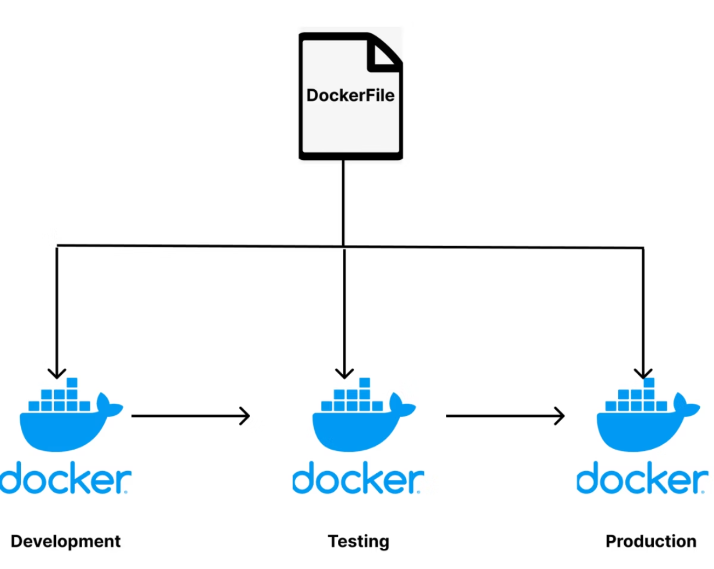
Multi-Stage Build Example
# Stage 1: BuildFROM golang:1.22 AS builderWORKDIR /appCOPY . .RUN go build -o myapp# Stage 2: RuntimeFROM gcr.io/distroless/baseCOPY --from=builder /app/myapp /usr/bin/myappCMD ["myapp"]
Final image is ~30MB instead of 800MB!
Multi-stage builds separate the build environment from the runtime environment, dramatically reducing image size.

Slide 7
Security Best Practices
Trusted Sources
Minimal Images
Always pull images from trusted registries
Use distroless / alpine images → smaller attack surface
Secret Management
Non-Root Users
Do not hardcode secrets in Dockerfile
Run containers as non-root user
Least Privilege
Regular Updates
Apply least privilege principle
Regularly update base images

Slide 8





Security Scanning
Why?
Tools:
Most vulnerabilities come from OS libraries in base images
Docker Scout
What to scan?
Base image layers
Trivy (Aqua Security)
Application dependencies
Runtime configs (secrets, users, ports)
Grype (Anchore)
Clair
JFrog Xray

Slide 9
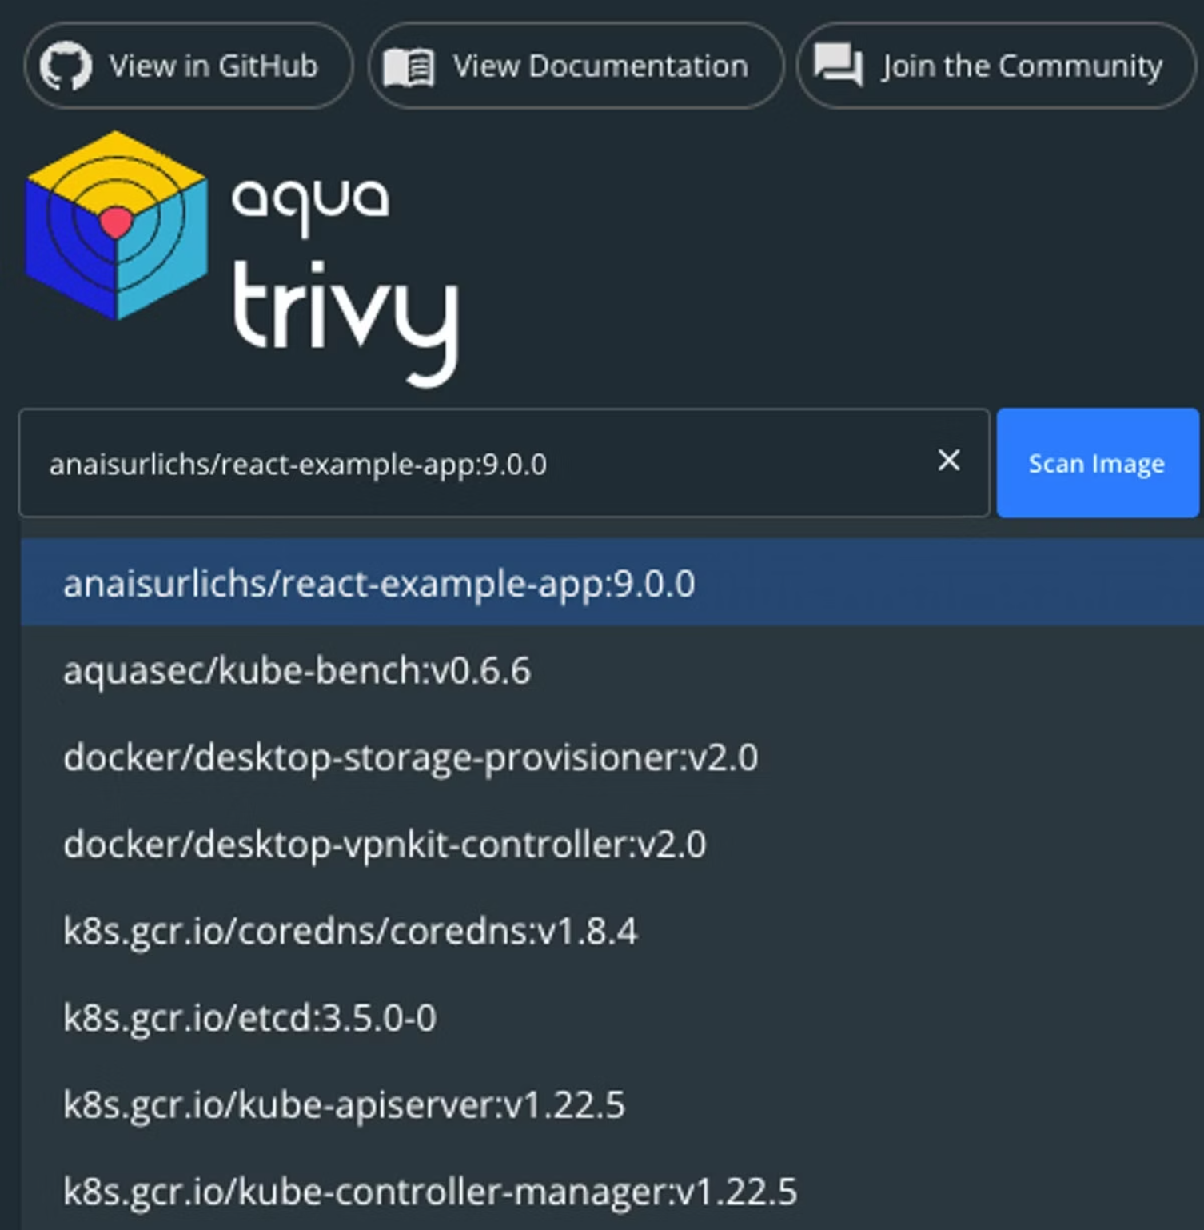
Security Scanning Demo (Trivy)
# Scan an imagetrivy image myapp:latest# Scan file systemtrivy fs .# Scan Git repotrivy repo https://github.com/org/repo
Output → CVEs, severity, fix recommendations
Trivy is a comprehensive vulnerability scanner that can detect issues in container images, filesystems, and Git repositories.

Slide 10
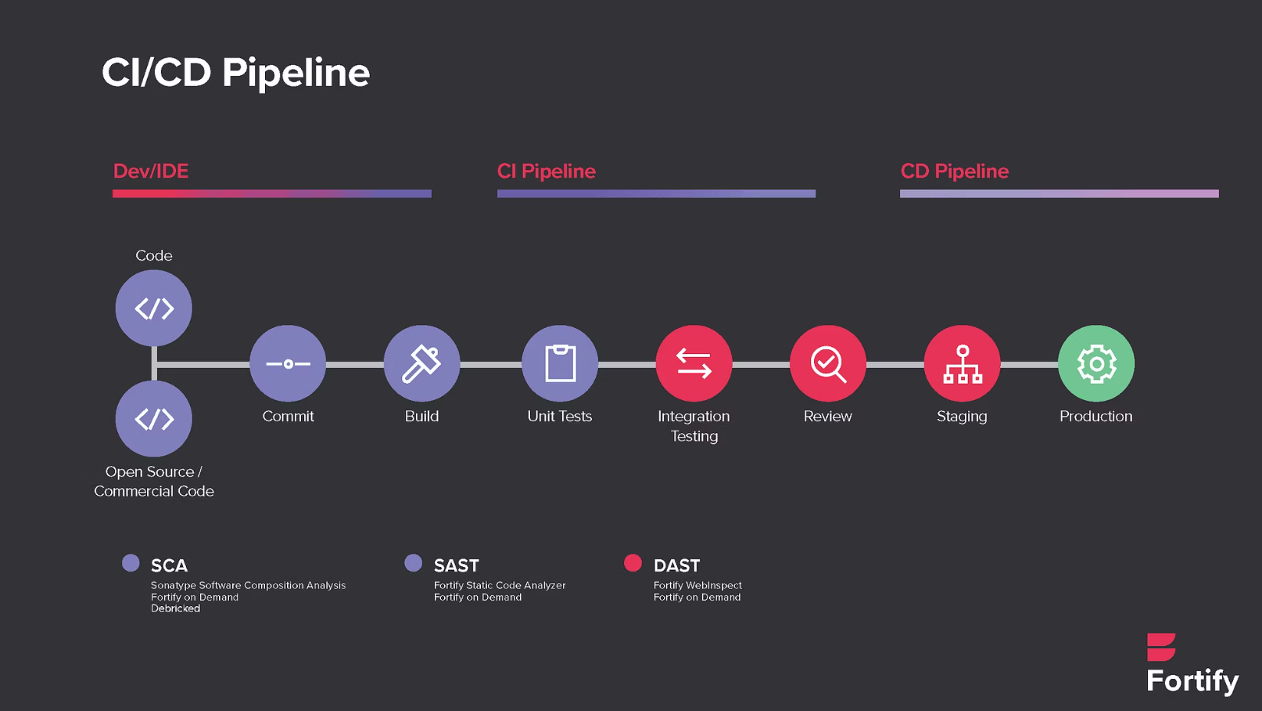
CI/CD Integration
Add scanning to build pipeline
Example (GitHub Actions + Trivy):
- name: Scan Docker image uses: aquasecurity/trivy-action@master with: image-ref: myapp:latest
Fail builds if Critical vulnerabilities are found
Integrating security scanning into your CI/CD pipeline shifts security left and prevents vulnerable images from reaching production.

Slide 11

Compliance & Policy
Security Policies
Image Signing
Block images with CVSS ≥ 7
Require signed images (cosign, Notary v2)
Registry Controls
Monitoring
Store only scanned images in private registry
Maintain audit logs & monitoring

Slide 12



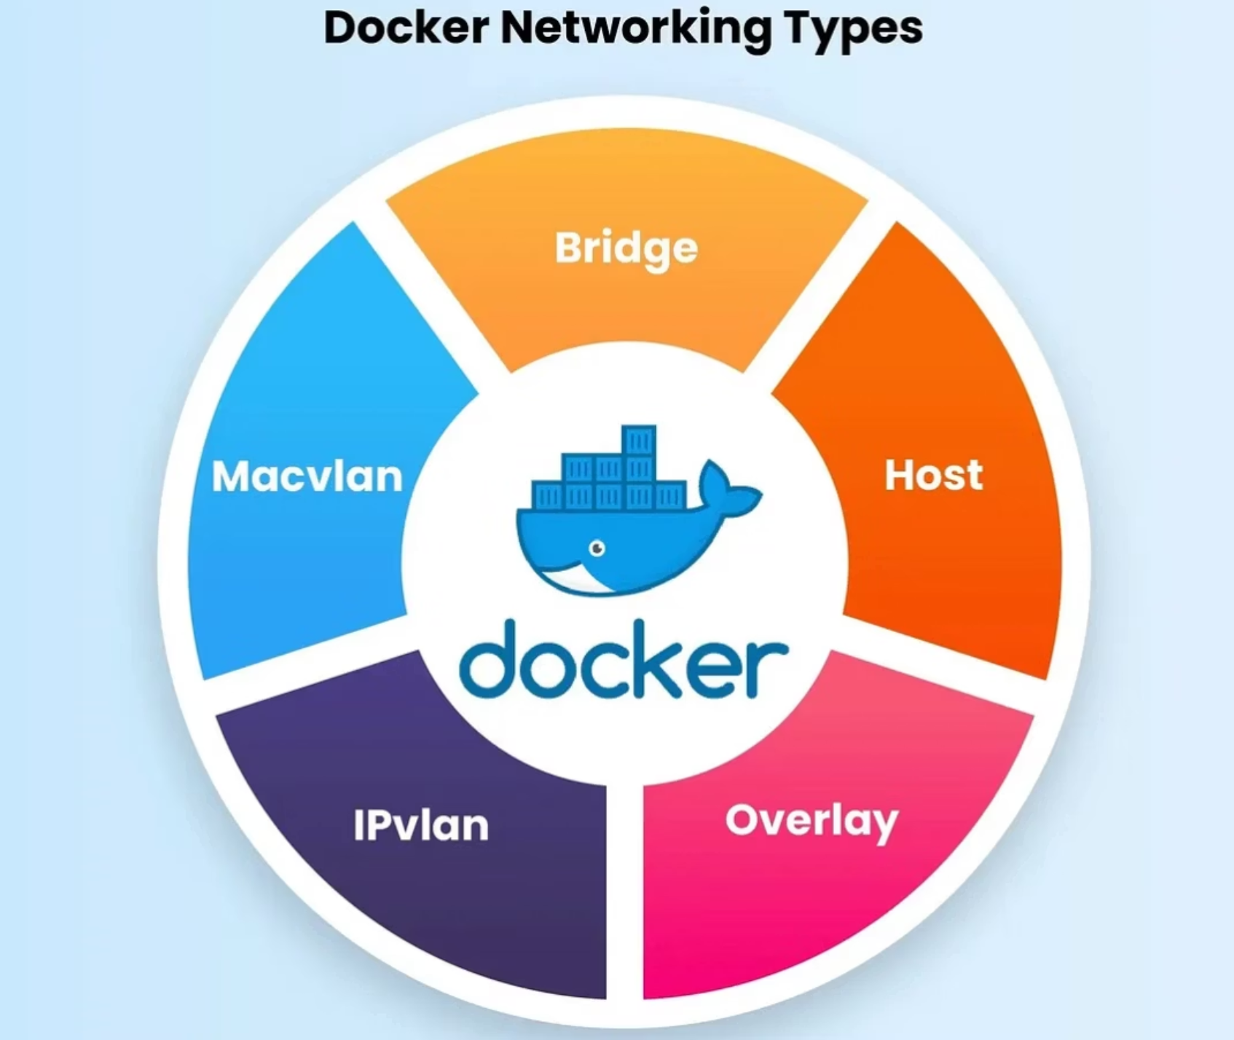

Example Workflow & Summary
Secure Docker Workflow
Key Takeaways
Developer pushes code
✅ Use official, minimal base images
✅ Optimize with multi-stage builds & cleanup
✅ Apply security scanning in CI/CD
CI builds multi-stage image
✅ Shift-left: developers take responsibility early
✅ Goal: Fast, Secure, Maintainable images
Trivy/Scout scans → results sent to CI
Signed + scanned image pushed to registry
Kubernetes pulls only trusted, verified images

